Slide 1

Influencers Analysis :Business Purpose
Rabbi Islam Yeasin
Engineer of Computer Science
IBM Certified Professional Data Scientist
Data Science Intern, InternInfoTech
Ex Machine Learning Intern, Mentorness
rabbi.yeasin-arena.com

Slide 2
Case Study Data Starting from March 2022 to Dec 2022
Influencers are categorized by the number of followers they have on social media. They include celebrities with large followings to niche content creators with a loyal following on social-media platforms such as YouTube, Instagram, Facebook, and Twitter.Their followers range in number from hundreds of millions to 1,000. Influencers may be categorized in tiers (mega-, macro-, micro-, and nano-influencers), based on their number of followers.
Businesses pursue people who aim to lessen their consumption of advertisements, and are willing to pay their influencers more. Targeting influencers is seen as increasing marketing's reach, counteracting a growing tendency by prospective customers to ignore marketing.
Marketing researchers Kapitan and Silvera find that influencer selection extends into product personality. This product and benefit matching is key. For a shampoo, it should use an influencer with good hair. Likewise, a flashy product may use bold colors to convey its brand. If an influencer is not flashy, they will clash with the brand. Matching an influencer with the product's purpose and mood is important.

Slide 3
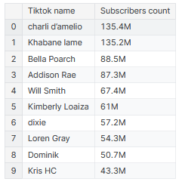
Tiktok Dataset Analysis – from a business Pespection
In TikTok dataset there is not category and audience country data so I didn't find it useful to tell a buisnessmen that which influencer must be approached by them categorywise
TOP 10 most followed celebrity on Tiktok

Slide 4
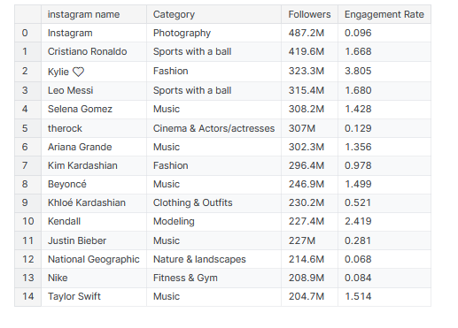
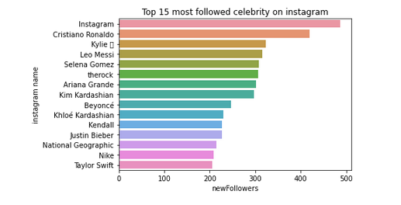
Top 15 Most Followed Celebrity on Instagram

Slide 5
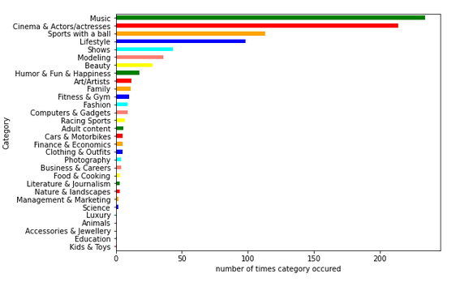
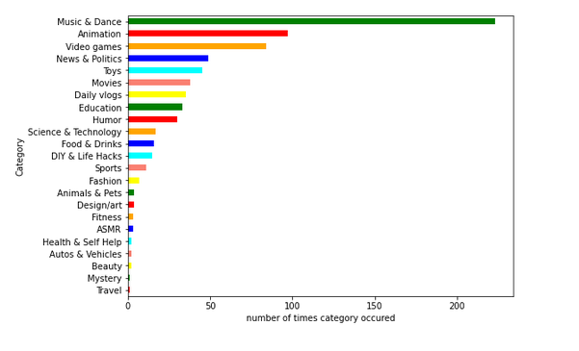
TOP Categories followed on Instagram Vs Youtube (POPULAR CATEGORIES ON INSTAGRAM and Youtube)
Instagram
Youtube

Slide 6
Observation from Instagram and Youtube
some categories are not on both plateforms
some categories are more popular on instagram than youtube and vice versa
Example-EDUCATION and Animation is more popular on YOUTUBE the INSTAGRAM

Slide 7
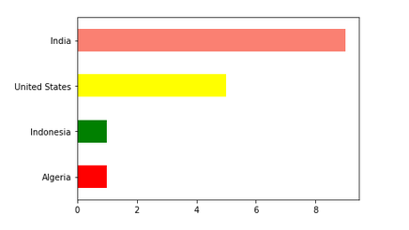
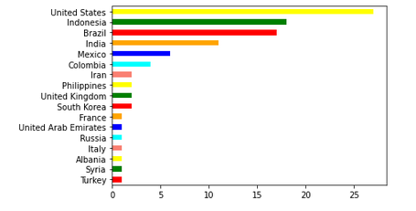
Checking the demand for categories by Country wise
Demand: Education
Demand: Lifestyle
Insights : make an advertisement of educational app then choose India

Slide 8
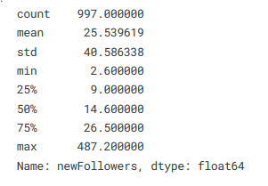

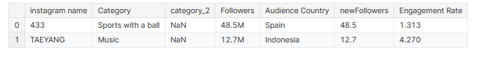
Want to go with mini followers for advertisement on Instagram?
Note : I am taking 60M as a threshold means for instagram celebrity havning above 60M followers are considerd to be mega celebrity
[threshold: a man made boundary to measure anything
According to Google : a level, point, or value above which something is true or will take place and below which it is not or will not.]
Threshold of New Followers
Output (Globally)

Slide 9
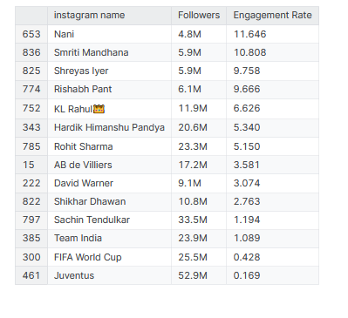
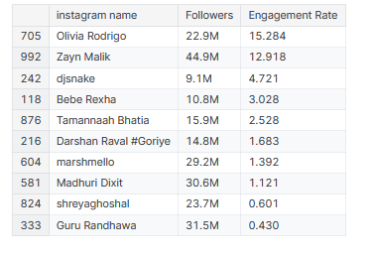
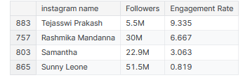
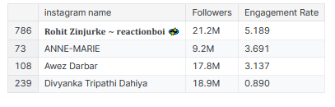
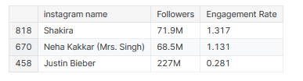

want to make ads by Mega-mini influencers from Instagram Category : Music ,Beauty, Shows, Sports with a Ball; Location : India
Mini Followers from Instagram(Beauty)
Mini Followers from Instagram(Music)
Mini Followers from Instagram(SwB)
Mini Followers from Instagram(Show)
Mega Followers from Instagram (Music)
Mega Followers from Instagram (SwB)

Slide 10





Thank You
Rabbi Islam Yeasin
Engineer of Computer Science
IBM Certified Professional Data Scientist
Data Science Intern , InternInfoTech
Ex Machine Learning Intern, MentorNess

